Slide 1
Digital Electronics and Systems

Slide 2
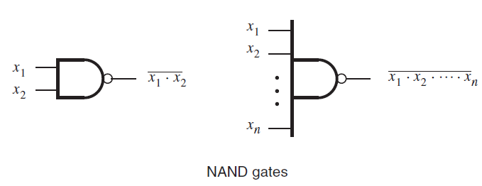

NAND and NOR Logic Networks
NAND and NOR gates are known as universal gates , since any logic function can be implemented using NAND or NOR gates.
NAND gate

Slide 3
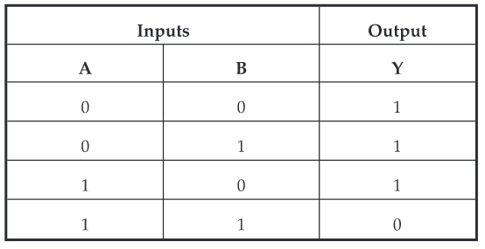
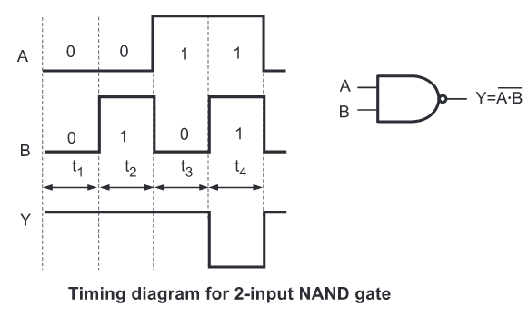

Slide 4
NOT function using NAND gate
A NOT function [inverter] can be made from a NAND gate by connecting all of the inputs together and creating, in effect, a single common input.

Slide 5
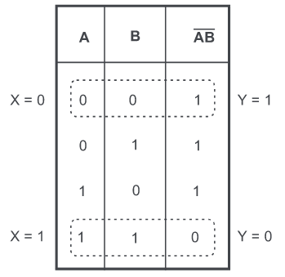
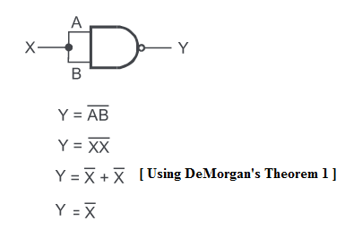

Slide 6

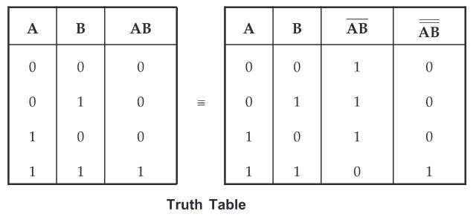
AND function using NAND gates
It is generated by simply inverting the output of NAND gate.

Slide 7
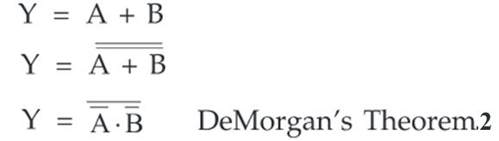
OR function using only NAND gates
We know that Boolean expression for OR gate is

Slide 8
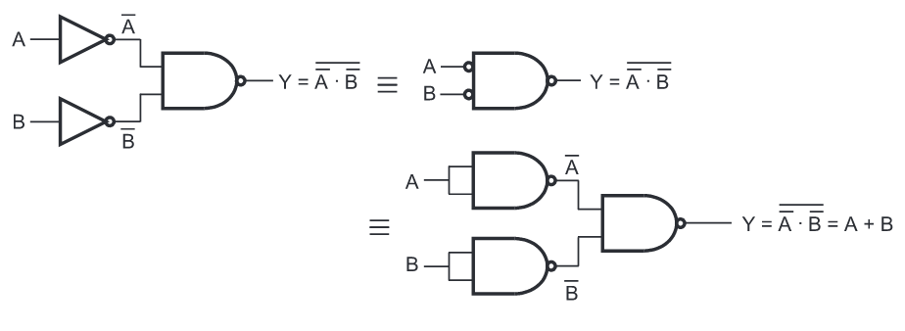
Bubble at the input of NAND gate indicates inverted input

Slide 9
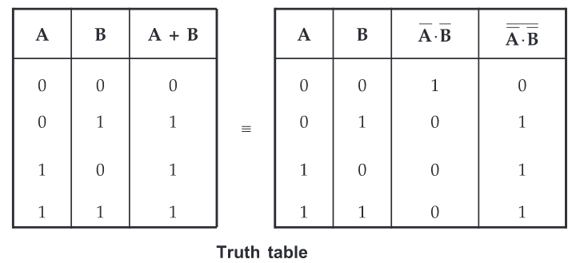

Slide 10
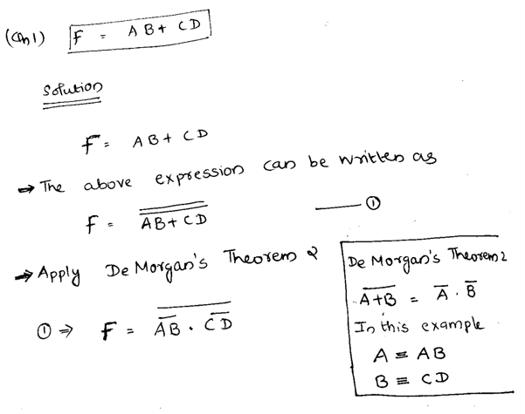
Design the following functions using NAND gates
Qn.1) F = AB + CD

Slide 11
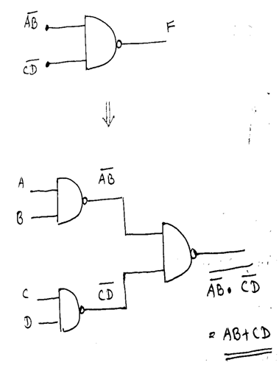

Slide 12
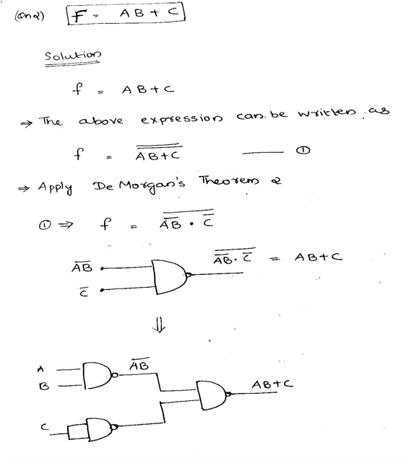
Qn 2) f = AB +C

Slide 13
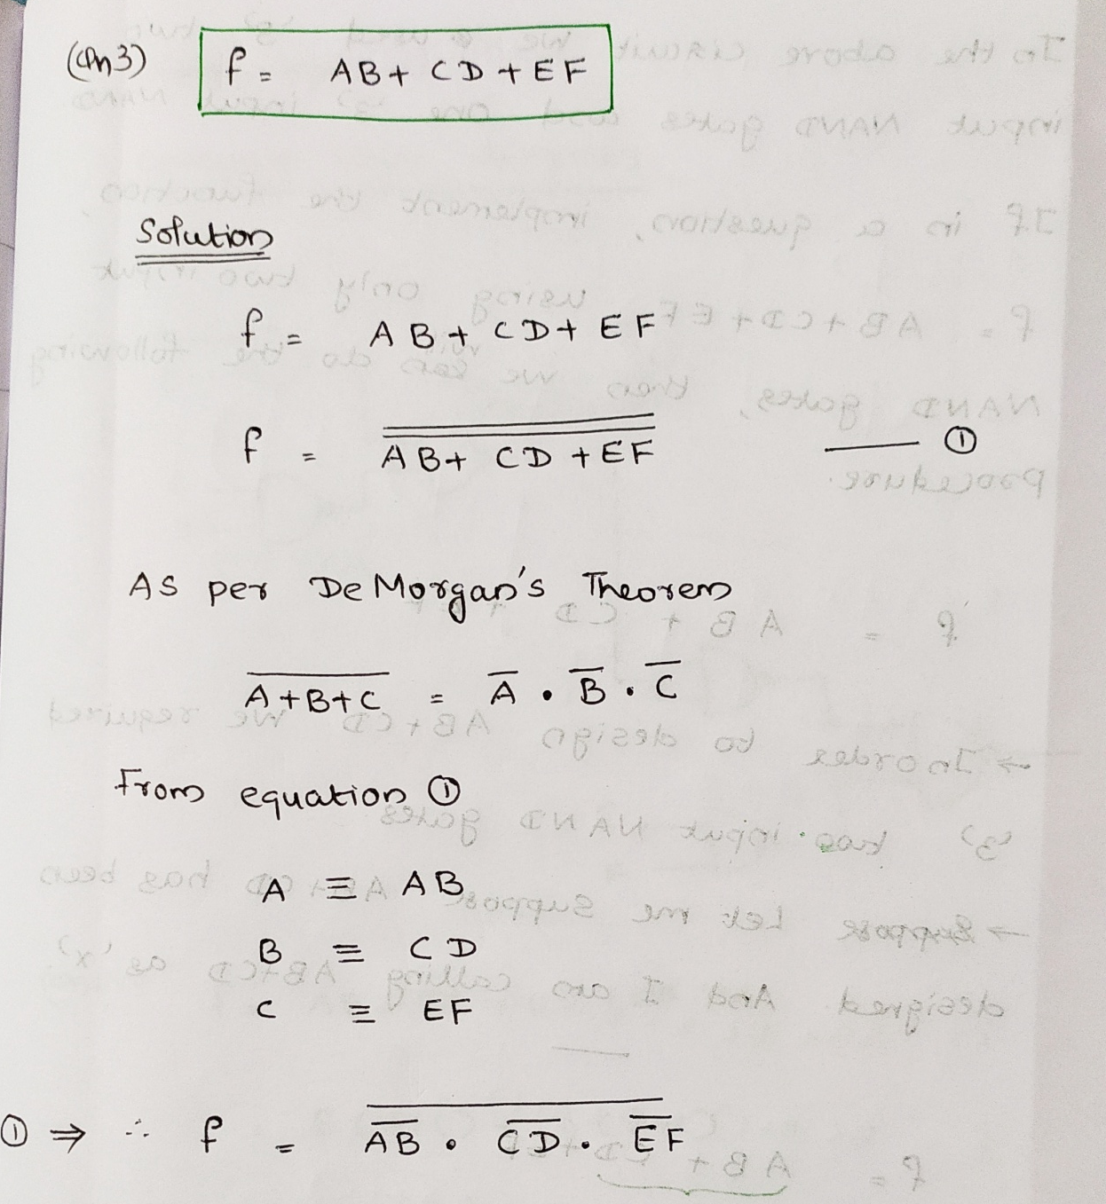
Qn 3) f = AB +CD +EF

Slide 14
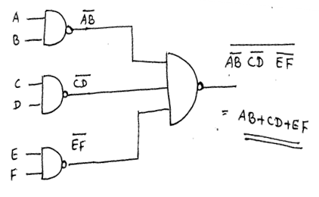

Slide 15
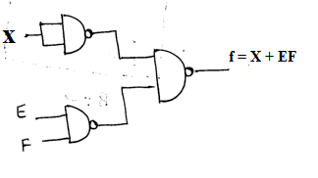
Implementation of f = AB +CD +EF using only two input NAND gates
f= AB + CD + EF
AB+CD = X
f= X +EF

Slide 16
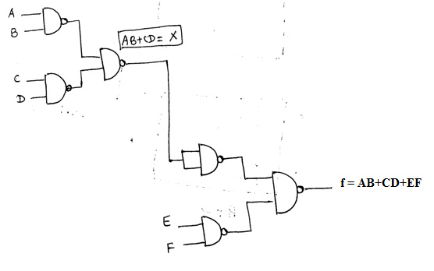
Final logic diagram

